Slide 1

Práctica airData
Juan Ortega Ortega
Alejandro del Rosal Carmona

Slide 2
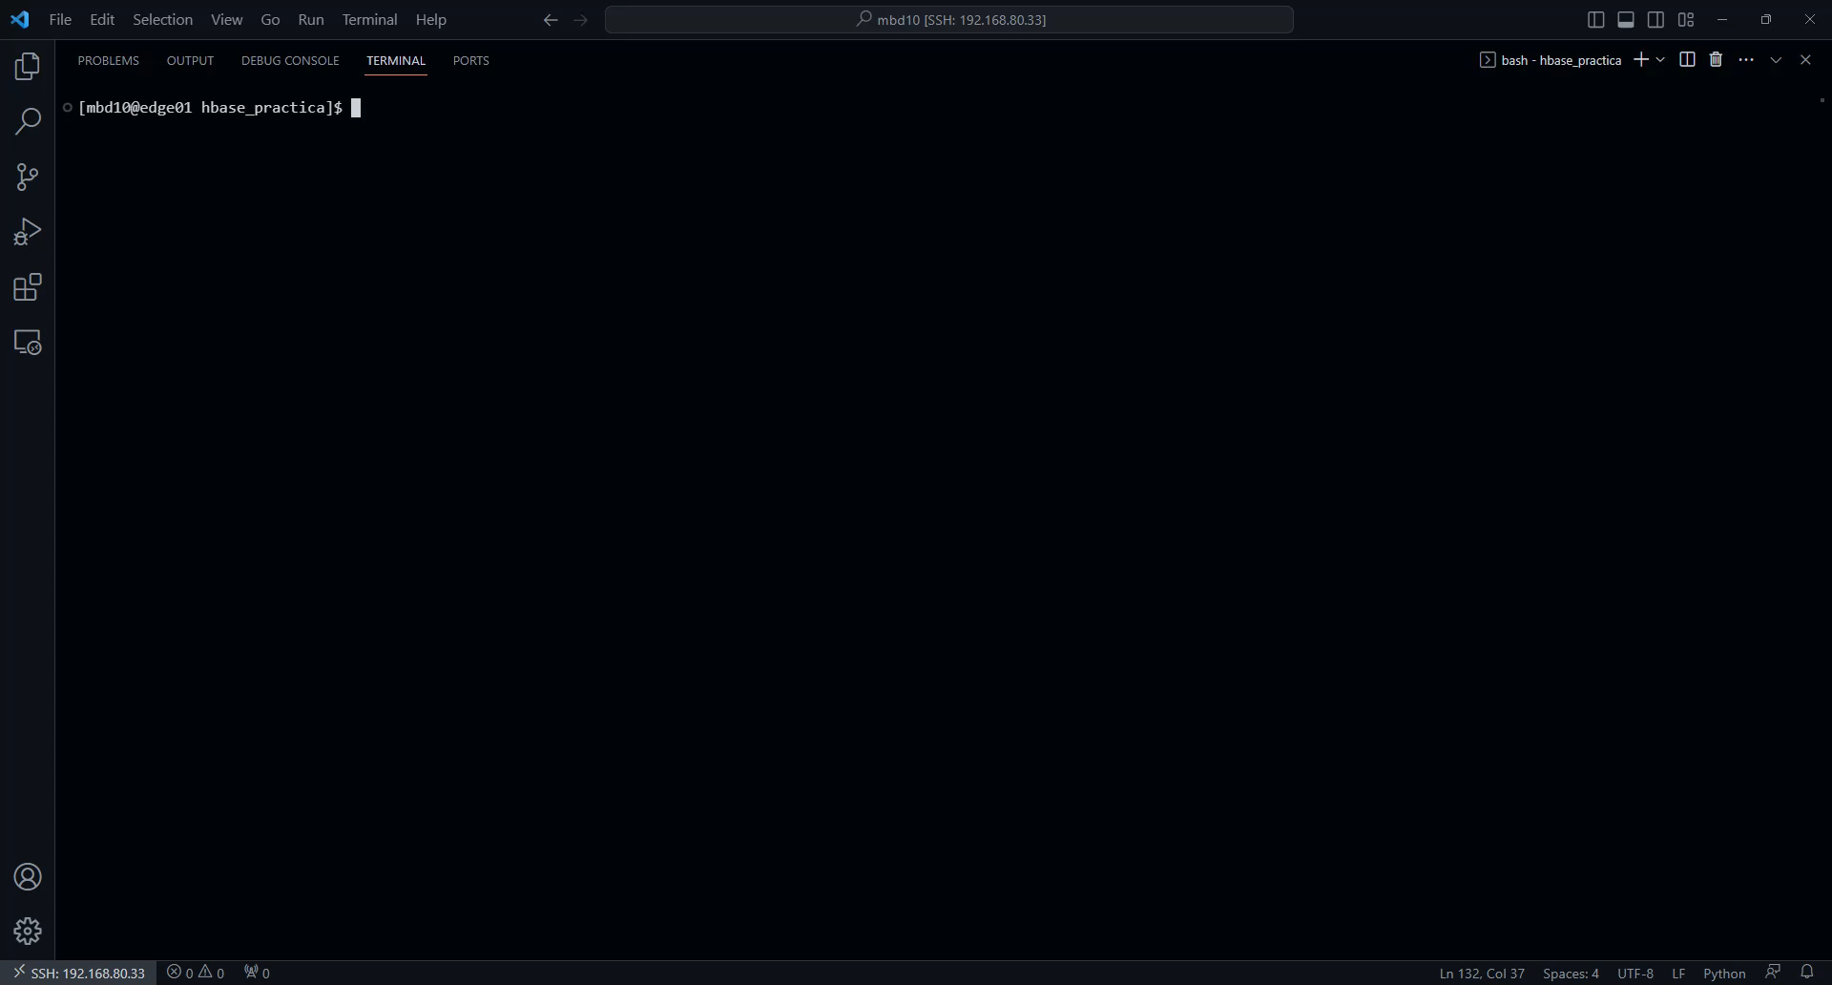
Detalle Aeropuertos

Slide 3
Detalle Vuelos: main
if __name__ == '__main__':
conn = getConn('0.0.0.0', args.namespace)
if conn.transport.is_open():
conn.close()
conn.open()
column_families = {
'info': dict()
}
file_path = ['/tmp/nosql/airData/2007.csv', '/tmp/nosql/airData/2008.csv']
create_table(conn, args.table, column_families)
for csv_year in file_path:
print('Datos:', csv_year)
load_data(conn, csv_year, args.table)
conn.close()

Slide 4
Detalle Vuelos: load_data
def load_data(conn, csv_path, table_name):
arr = [1000000*i for i in range(1, 11)]
with open(csv_path, 'r') as csvfile:
csvreader = csv.reader(csvfile)
next(csvreader) # Ignore headers
print('Iniciando carga de datos')
with conn.table(table_name).batch(batch_size=1000) as table:
count = 0
for row in csvreader:
row_key = to_bytes(row[0] + row[1].zfill(2) + row[2].zfill(2) + row[4] + '_' + str(count))
data = {
'info:Year': to_bytes(row[0]),
'info:Month': to_bytes(row[1]),
'info:DayofMonth': to_bytes(row[2]),
'info:DepTime': to_bytes(row[4]),
'info:ArrTime': to_bytes(row[6]),
'info:UniqueCarrier': to_bytes(row[8]),
'info:FlightNum': to_bytes(row[9]),
'info:TailNum': to_bytes(row[10]),
'info:Origin': to_bytes(row[16]),
'info:Dest': to_bytes(row[17]),
'info:Distance': to_bytes(row[18]),
'info:Cancelled': to_bytes(row[21]),
}
table.put(row_key, data)
count += 1
if count in arr:
print(f'{count} registros procesados')
print('Carga finalizada')

Slide 5

Consulta Rutas

